Slide 1
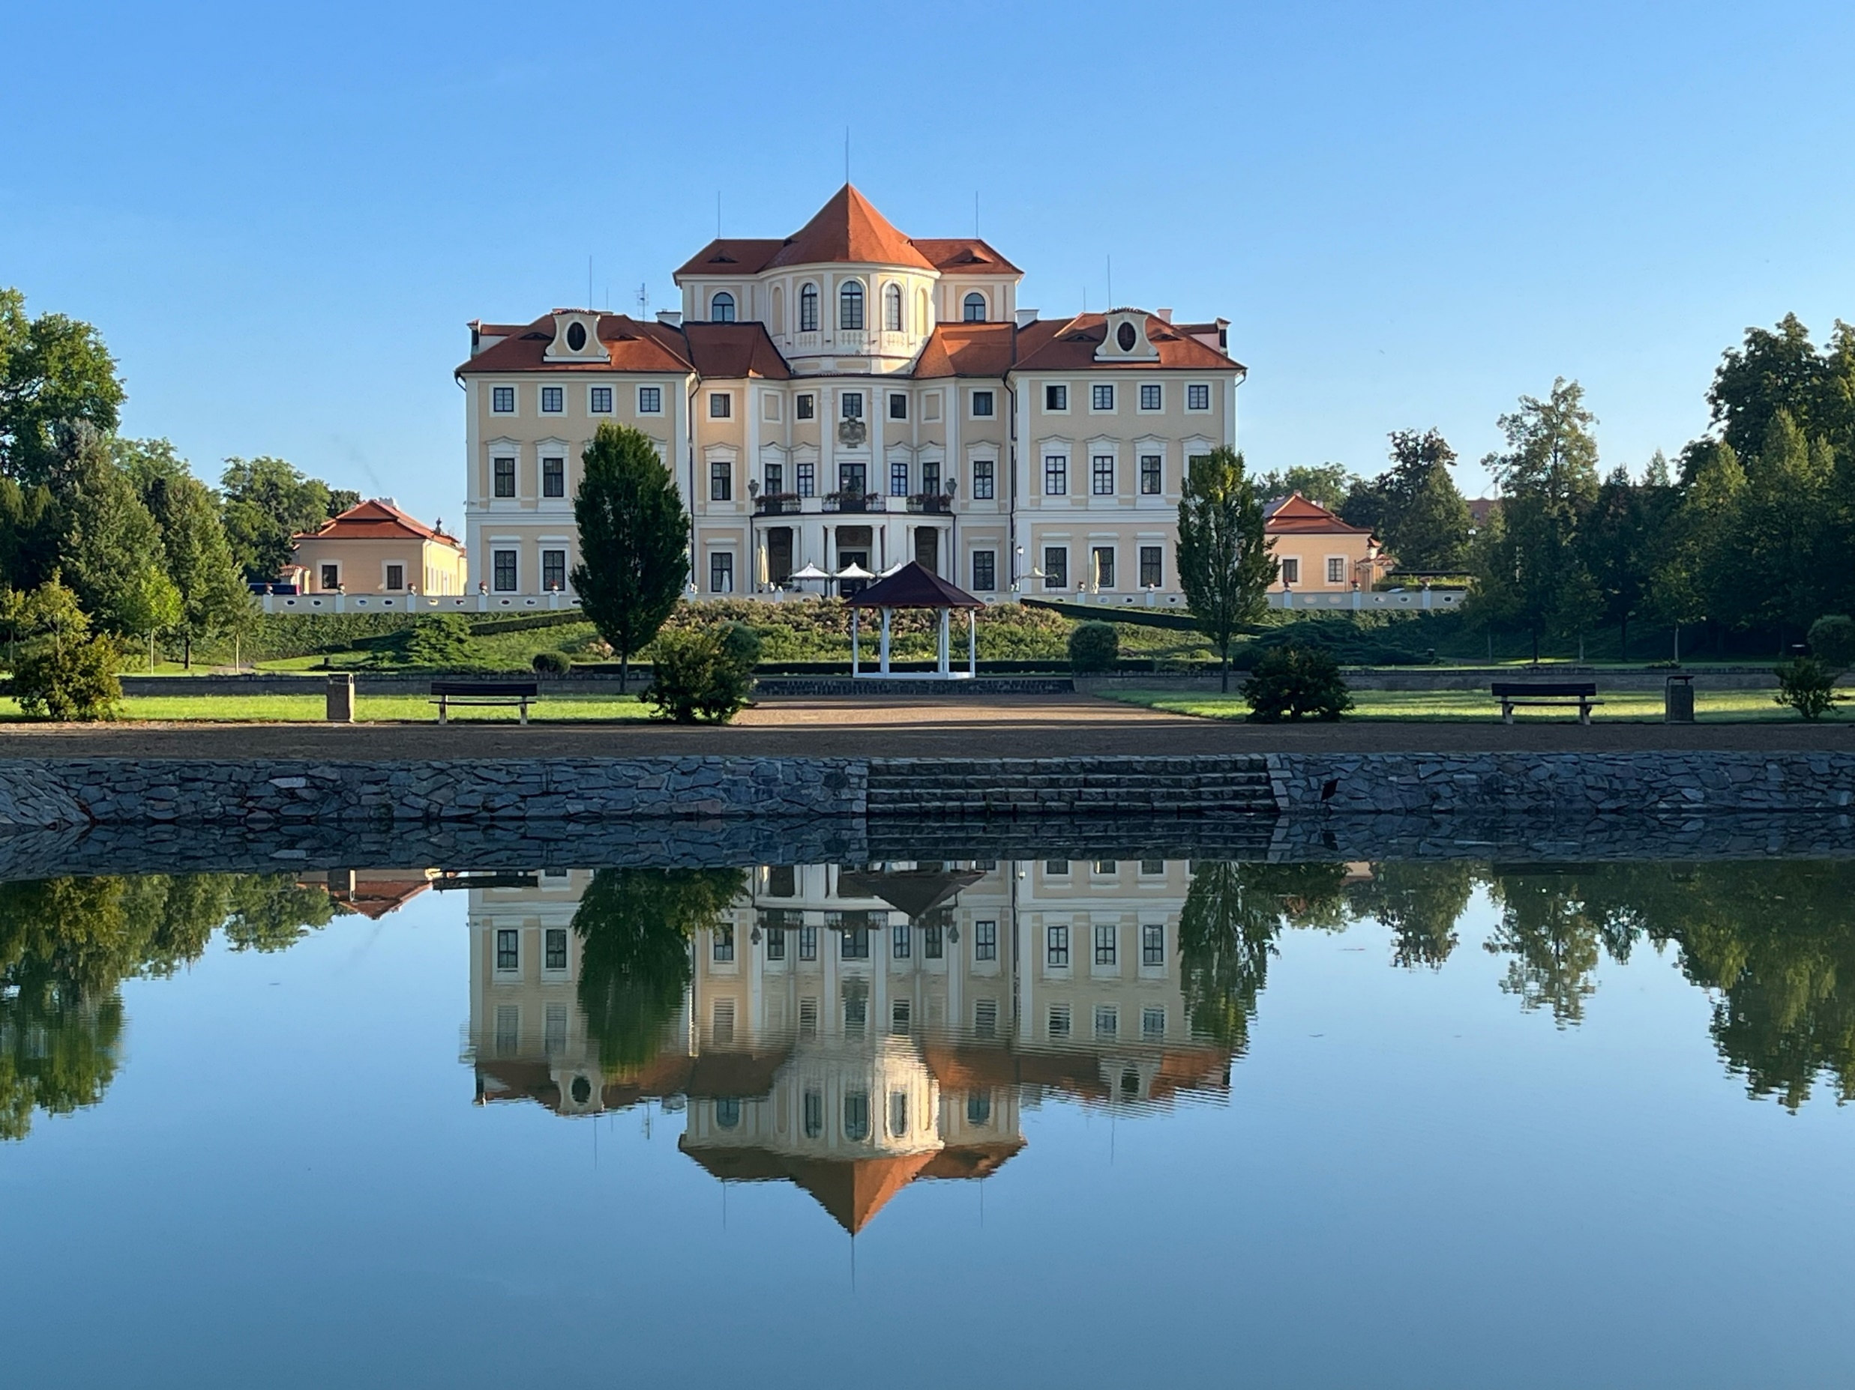
School on Catalysis
Liblice Castle, Czech Republic
May 28 - 30 2024
Invited lectures, e.g.:
CO₂ utilisation (Michele Aresta)
HR-TEM (Michal Mazur)
Polymer synthesis (Ondřej Sedláček)
Industrial Catalysis (Paul A. Diddams)
Student’s oral & poster presentations
Joint scientific event
Key Dates:
Deadline for Submission (no abstracts)
Notification of Acceptance Registration Deadline
Payment
20. 2. 2024
10. 3. 2024
20. 3. 2024
1. 4. 2024

